Slide 1

BlueTool Install and Test Command

Slide 2
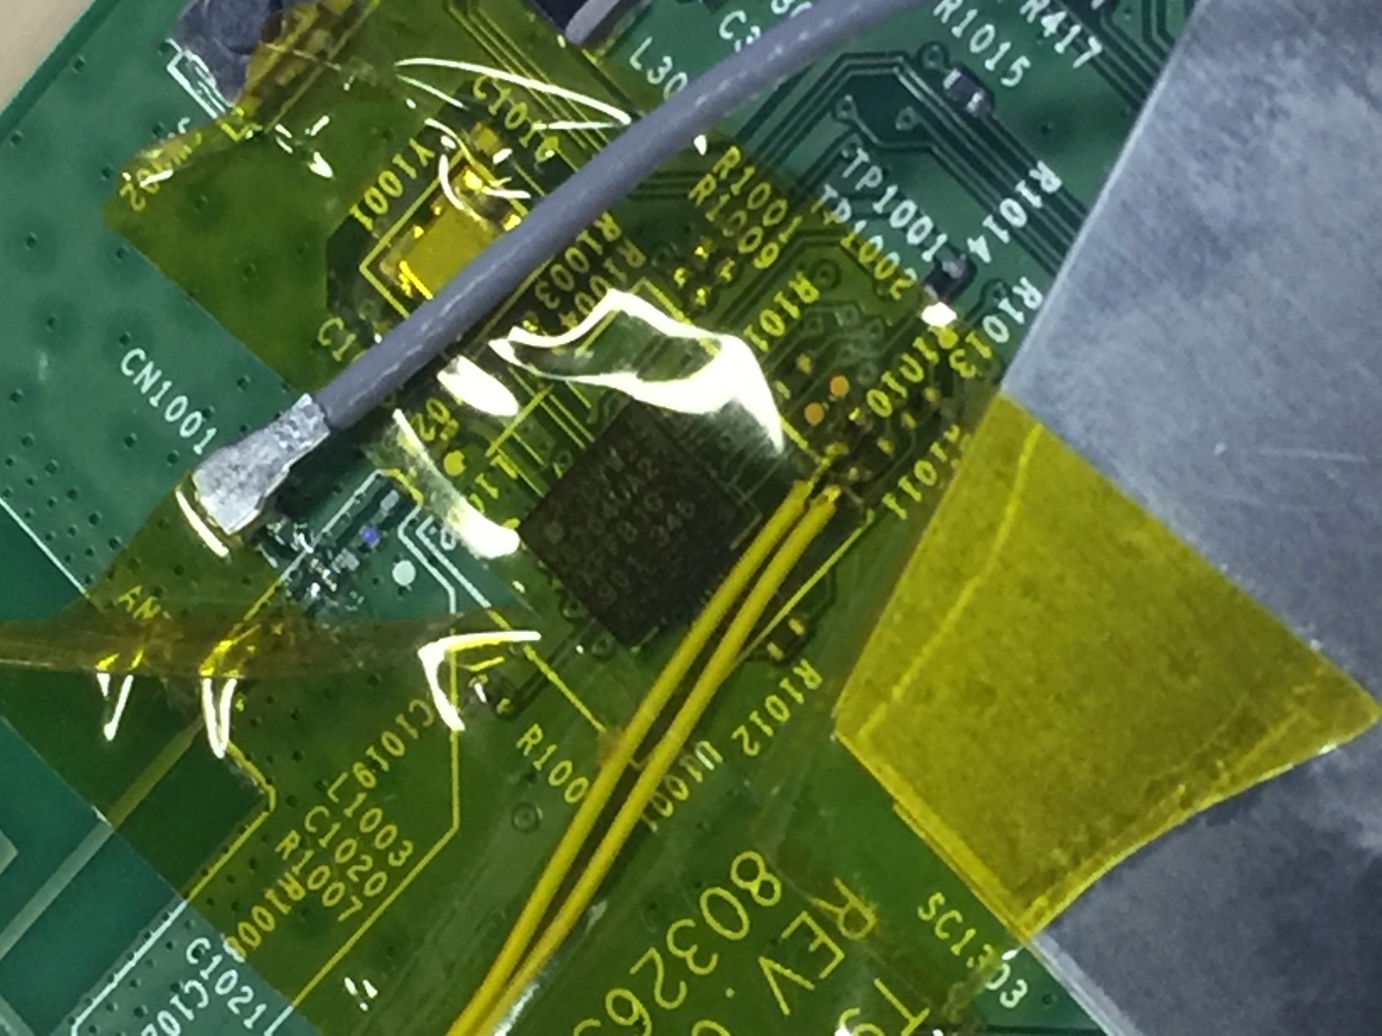
HW Rework
PCB jumper wire Tx、Rx、GND
Keep 0ohm of R1010、R1011
Along 0ohm jumper wire
R1011
(Rx)
R1010
(Tx)

Slide 3
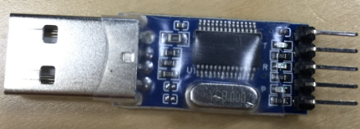
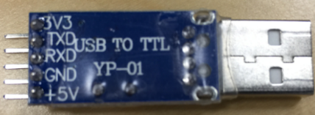
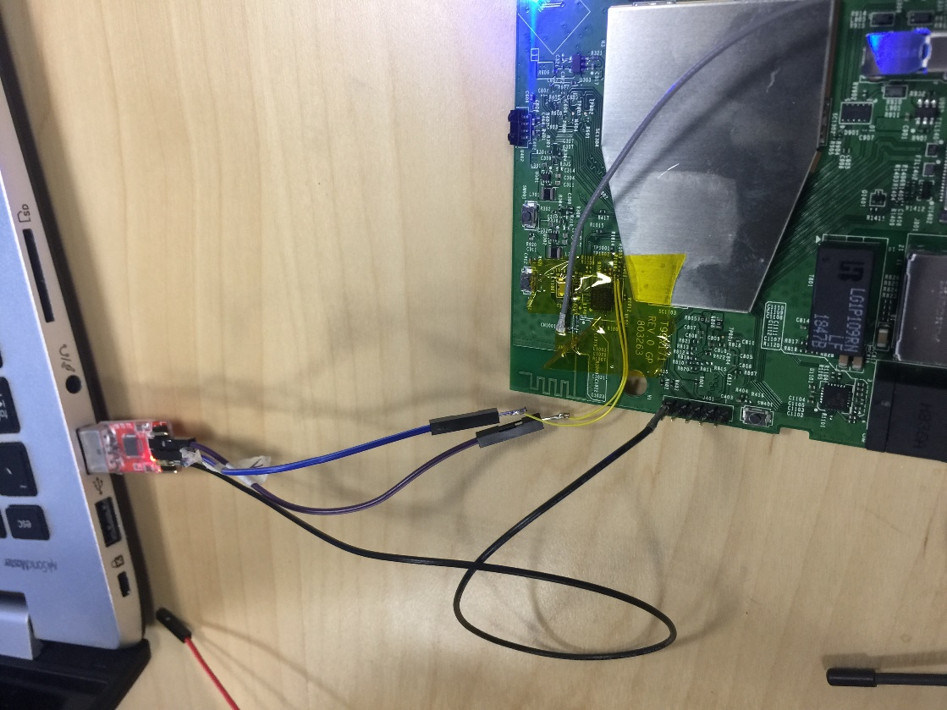
Important!!!
Must to use USB to TTL module serial converter, and connect Tx、Rx and GND to PCB
PCB
Tx
Rx
Tx(R1010)
GND
Rx(R1011)
GND

Slide 4
NOTE
If display error message, need to
(1) DUT Reset (power off and then power on again)
(2) Re-plug in USB to TTL dongle
(3) Close BlueTool and open tool again

Slide 5


A. Install BlueTool
Open Bluetool folder → Install ActivePerl-5.8.4.810-MSWin32-x86
Install BlueTool

Slide 6
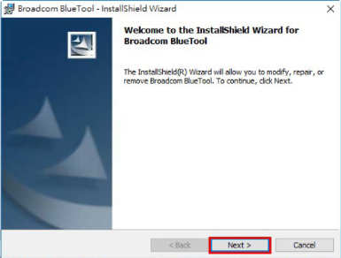
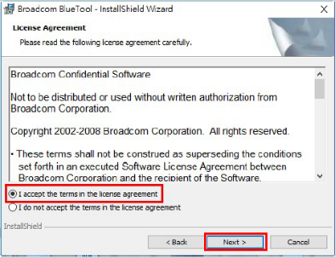
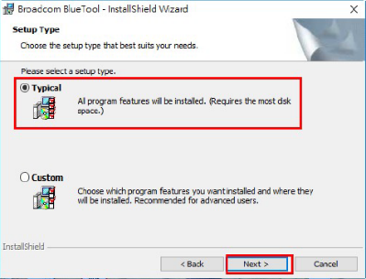
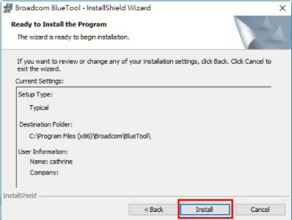
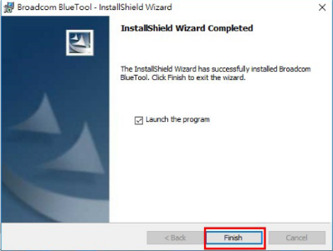
1

Slide 7
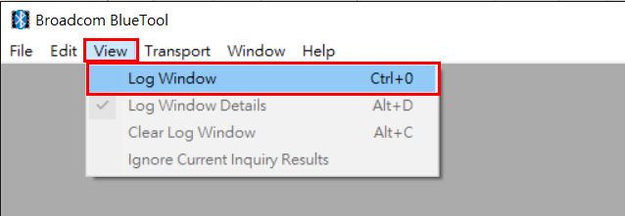
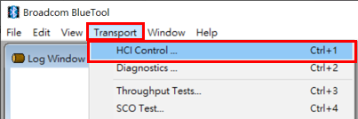
B. Enable Test Mode
NOTE！
After power on, need to wait 1 minute
and can start to deliver command
Open BlueTool
From the View menu, select Log Window
From the Transport menu, select HCI Control

Slide 8
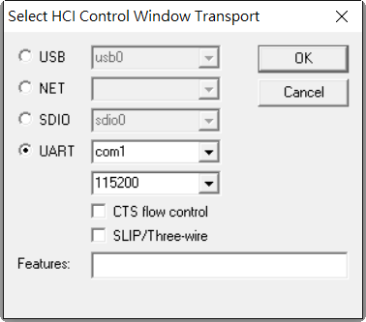
(1) In Select HCI Control Window Transport, select UART
(2) Key-in COM PORT, the same with device manager
(3) Select baud rate to 115200
(4) Cancel CTS flow control
(5) Click OK
(5)
(2)
(1)
(3)
(4)

Slide 9
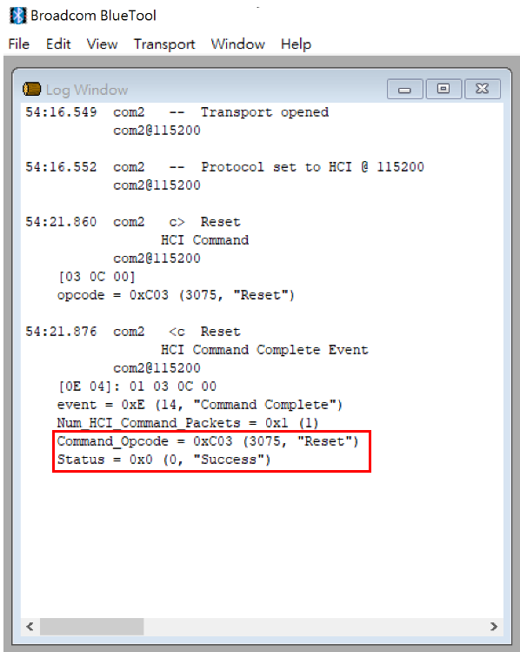
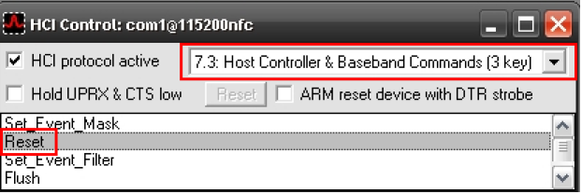
Reset
In the HCI Control Command Window
  Select 7.3 Host Controller & Baseband Command
  In the main body of the window, double-click Reset
  In the log window, the last line reads status = 0x0 (0, "Success")
(1)
(2)
(3)

Slide 10
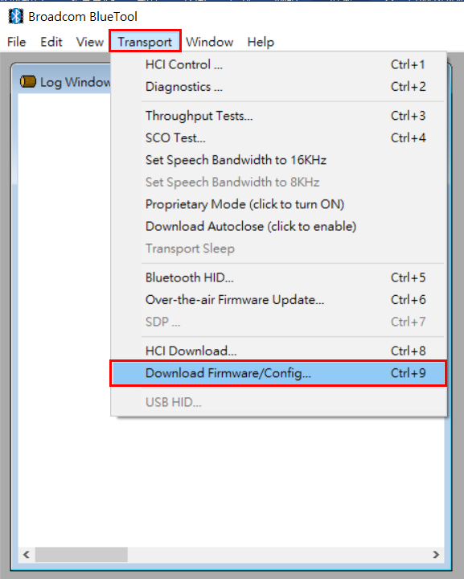
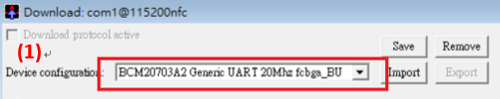
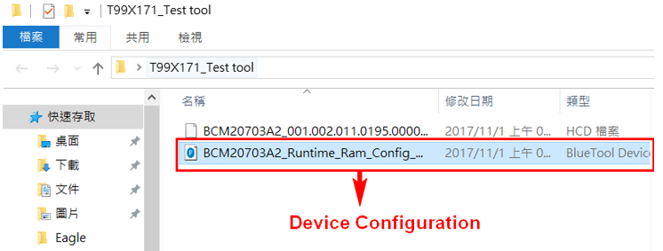
Download Firmware
Download Firmware
  From the Transport menu, select Download Firmware
  Device Configuration :
  Import → Select BCM20703A2_Runtime_Ram_Config_Download
(2)
(1)

Slide 11
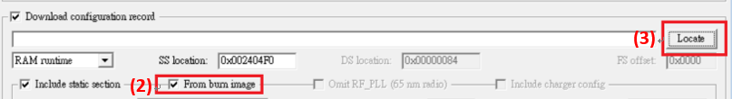
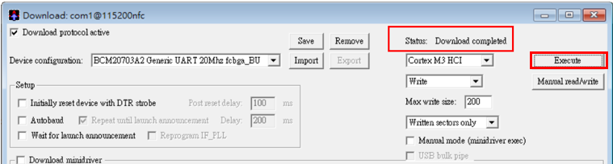
  (3) Select burn image
  (4) Click Locate → select CYW20704A2_001.002.011.0296.0298.hcd
  Click Execute
  Display Status : Download completed
(4)
(3)
(5)
(6)
2

Slide 12
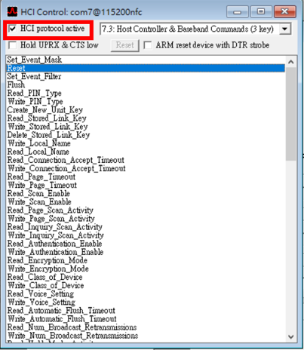
NOTE！ After complete download firmware, wait at least 40sec,
then click reset
Reset
(1) After Load FW → select HCI control window → select HCI protocol active
(2) Click Reset
(3) In the log window, the last line reads status = 0x0 (0, "Success")
(1)
(2)

Slide 13
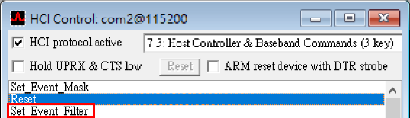
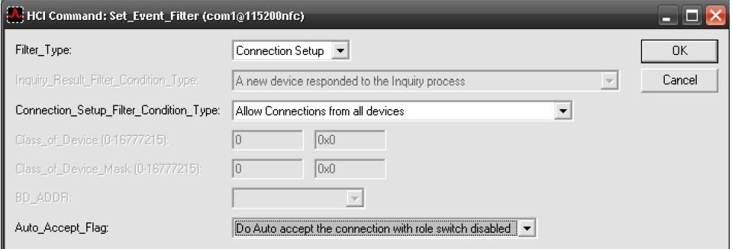
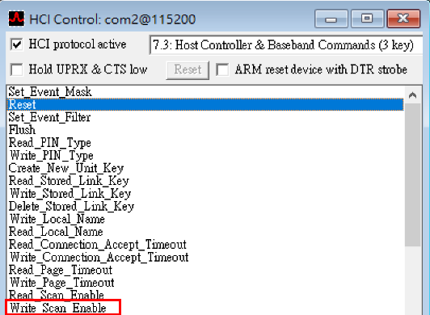
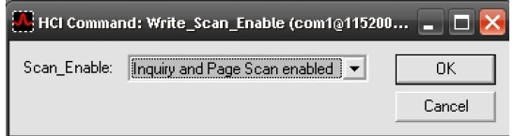
Set Event Filter
Success : In the log window, the last line reads status = 0x0 (0, "Success")
Write Scan Enable
  Success : In the log window, the last line reads status = 0x0 (0, "Success")

Slide 14
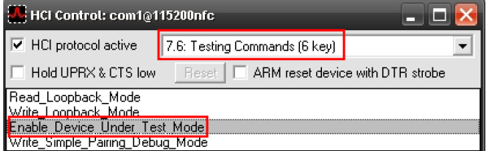
Enable Test Mode
Success : In the log window, the last line reads status = 0x0 (0, "Success")

Slide 15
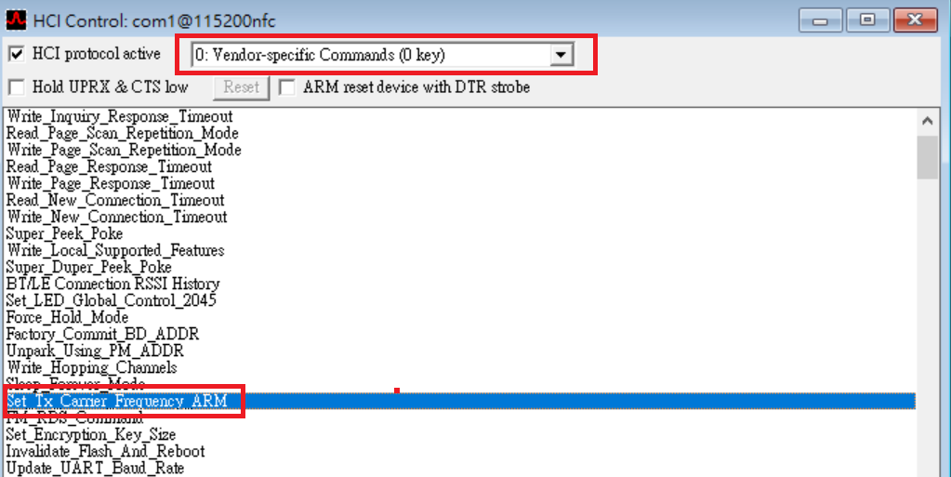
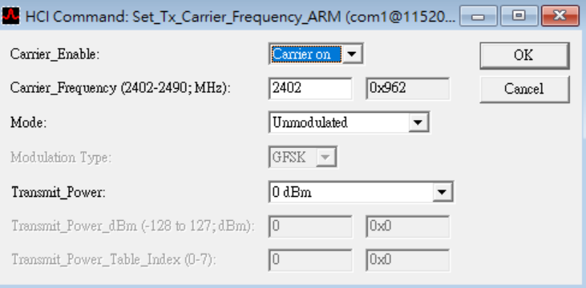
C. Set Tx Carrier Frequency ARM

